Slide 1


Slide 2
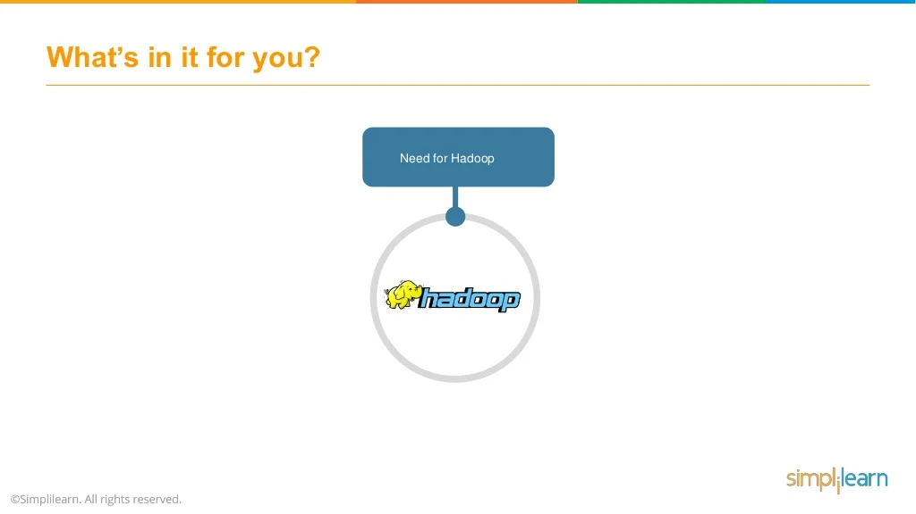

Slide 3
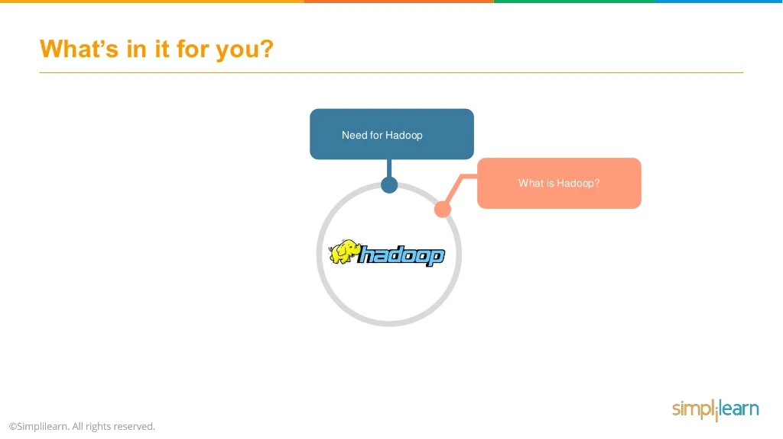

Slide 4
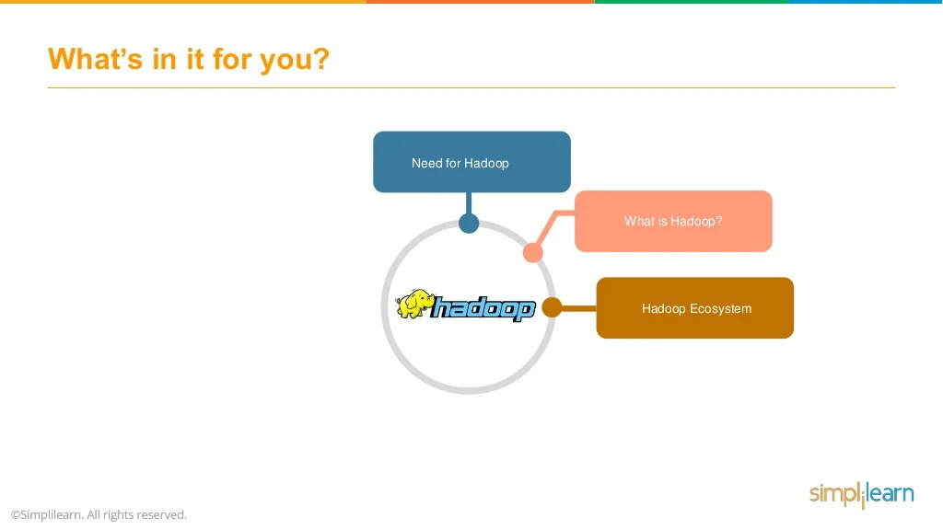

Slide 5
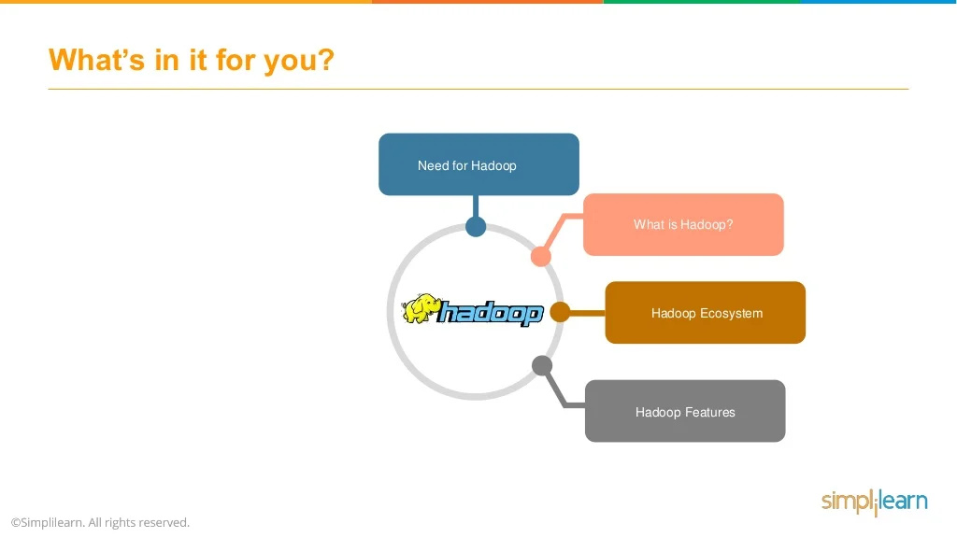

Slide 6
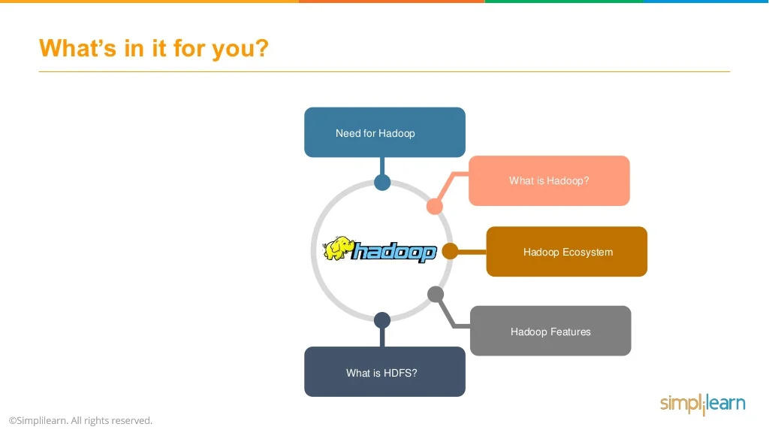

Slide 7
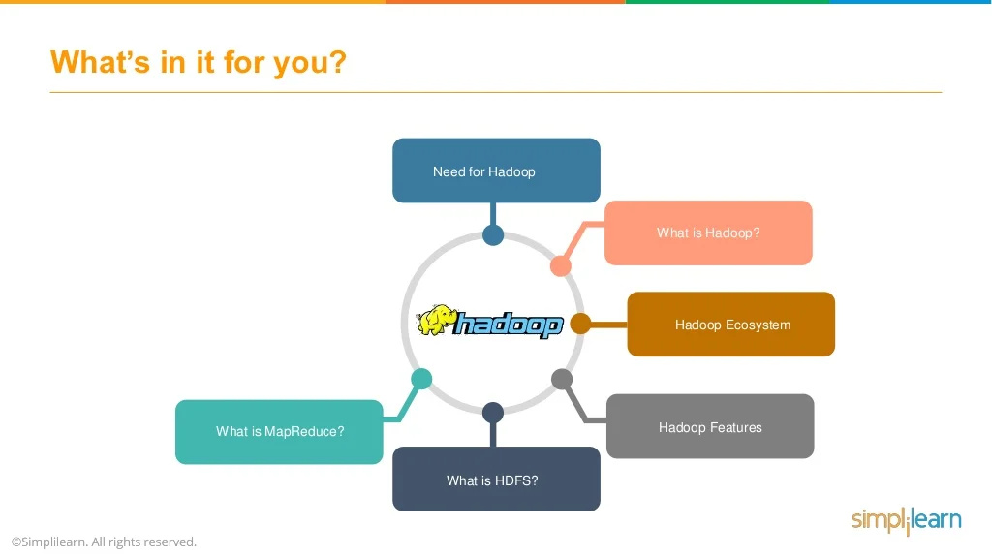

Slide 8
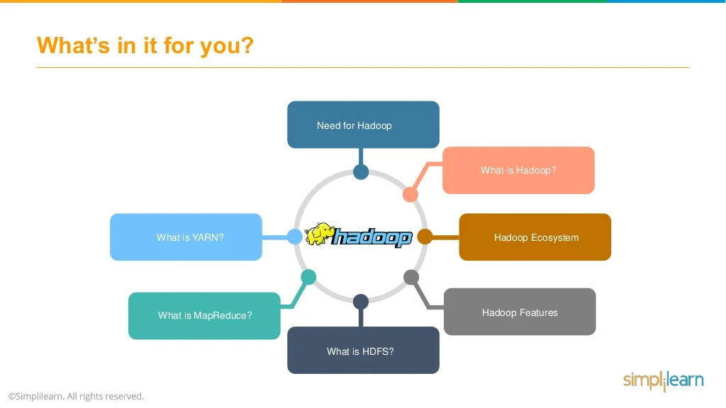

Slide 9
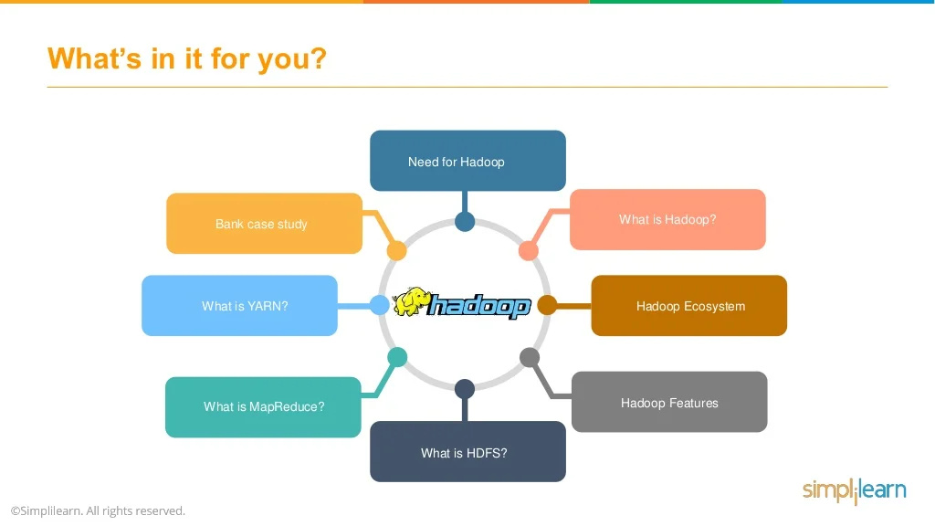

Slide 10


Slide 11


Slide 12


Slide 13


Slide 14


Slide 15
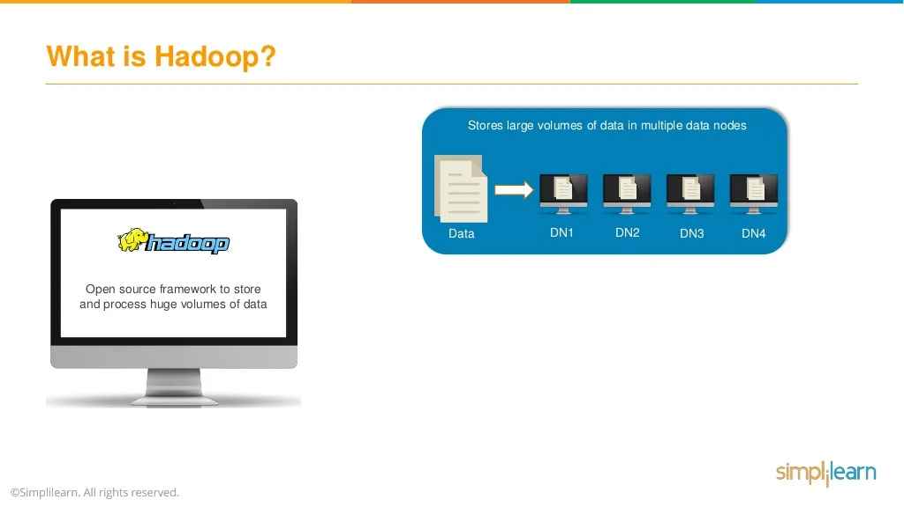

Slide 16
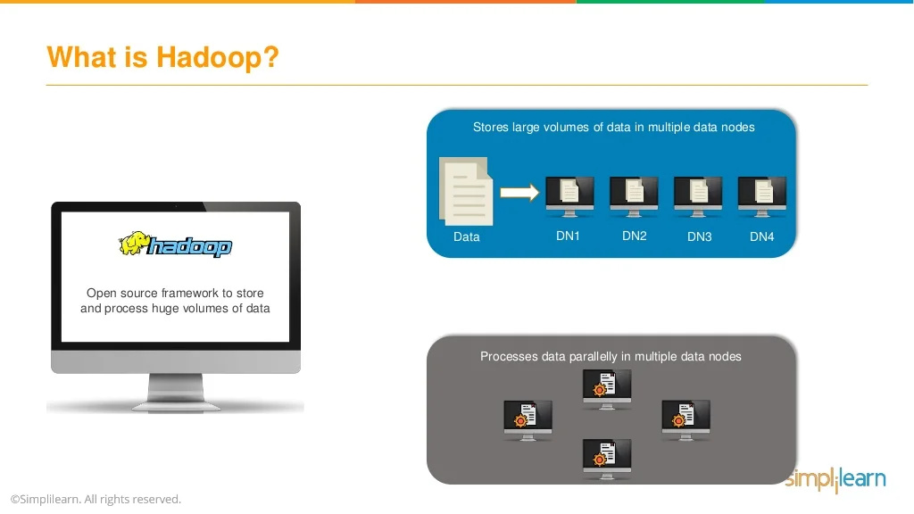

Slide 17
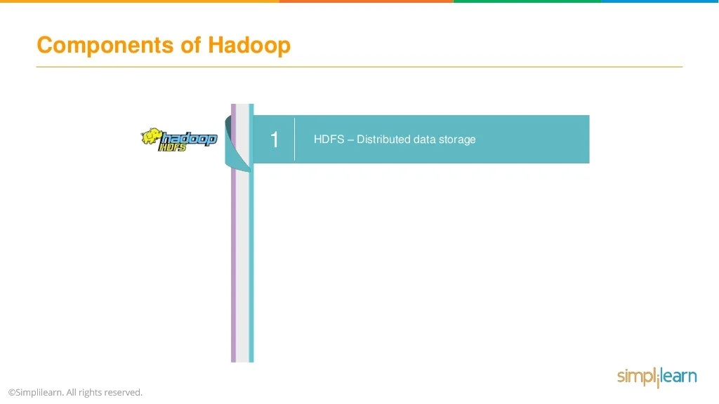

Slide 18
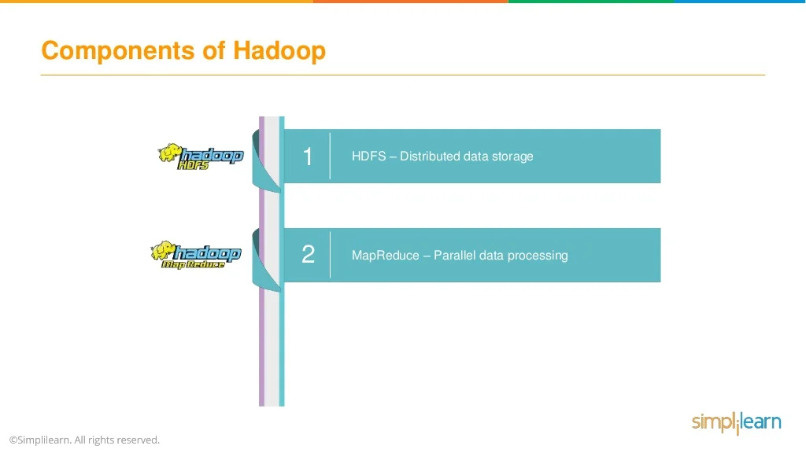

Slide 19
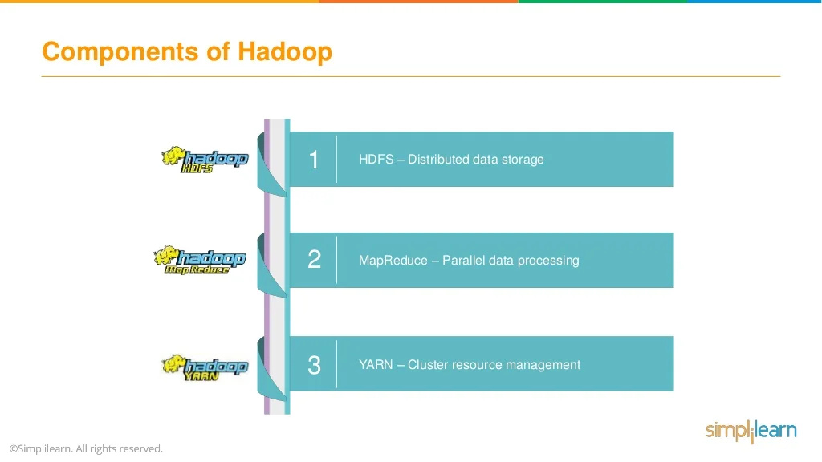

Slide 20
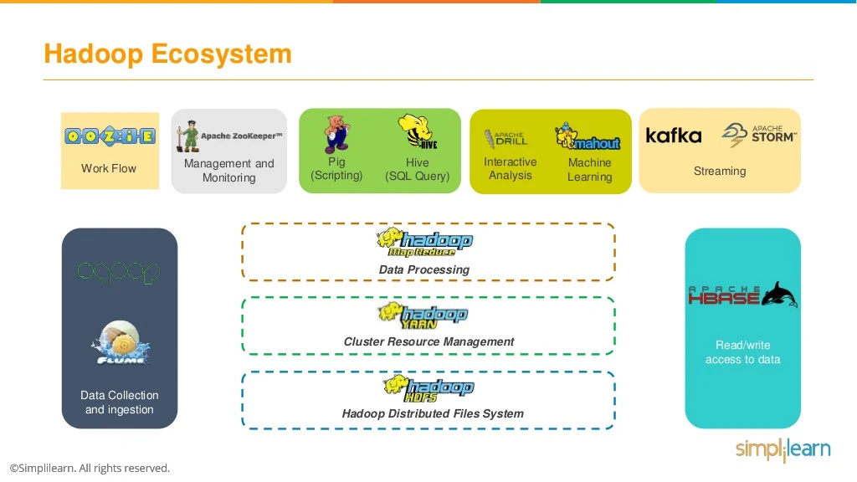

Slide 21
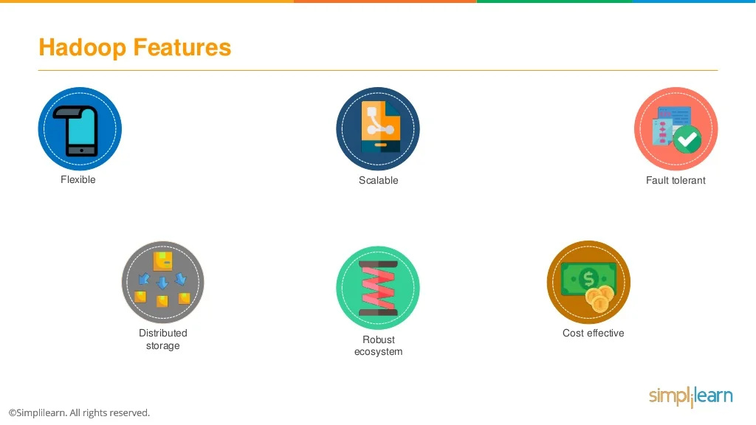

Slide 22
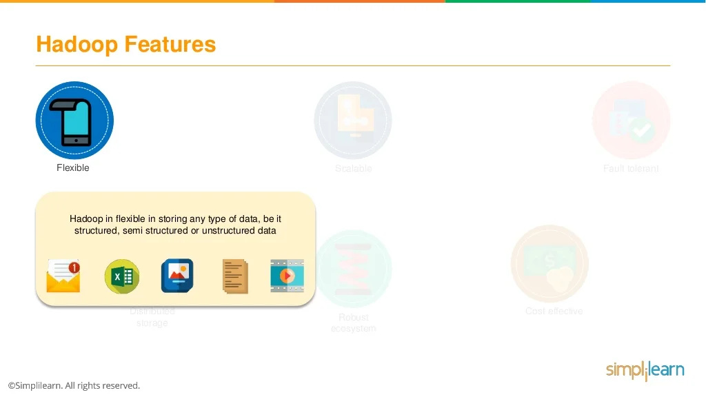

Slide 23
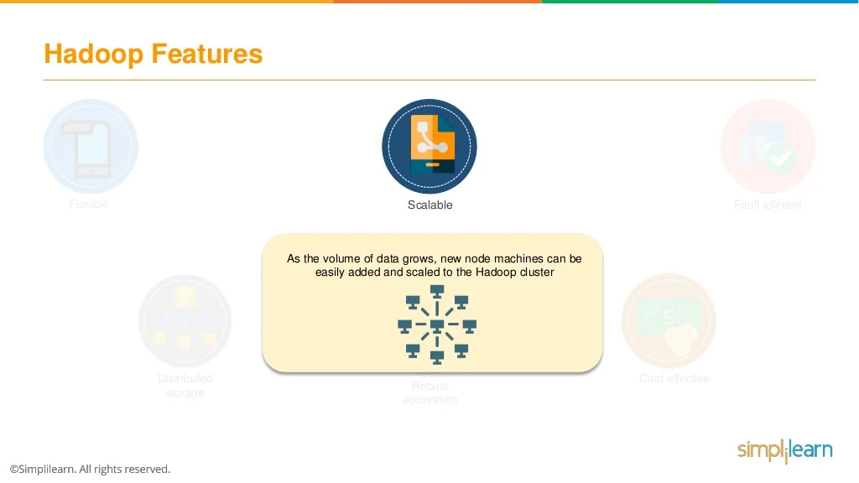

Slide 24
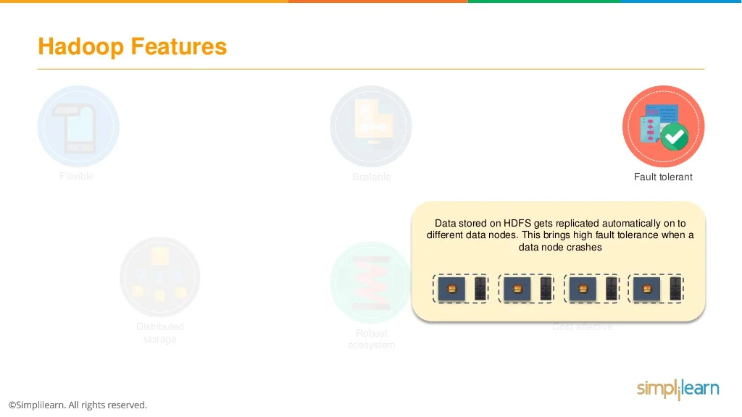

Slide 25
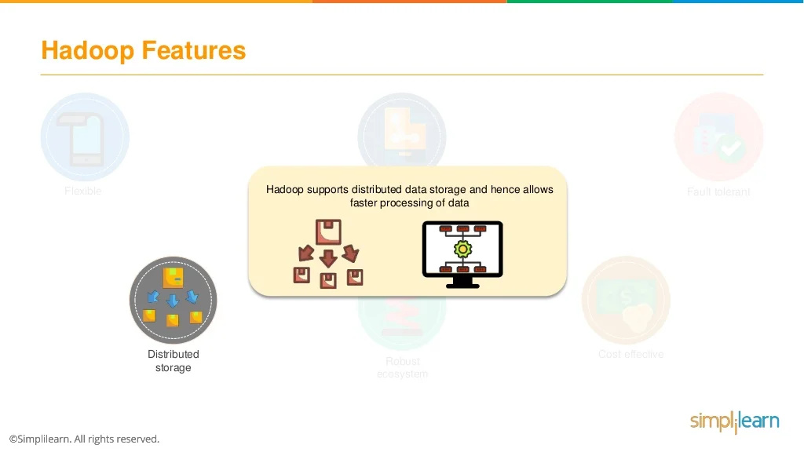

Slide 26
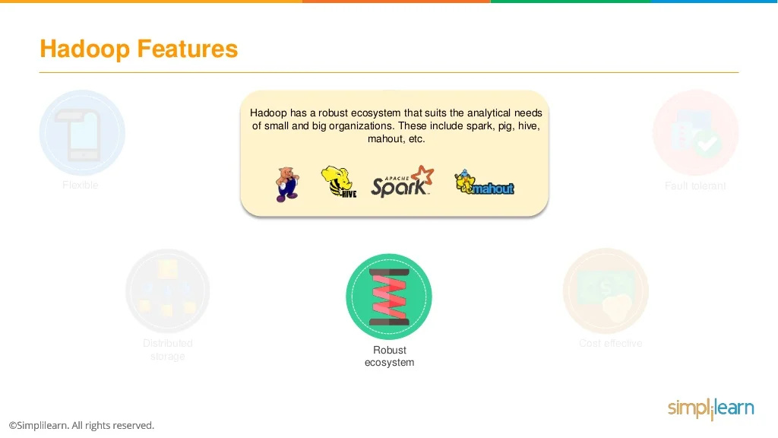

Slide 27
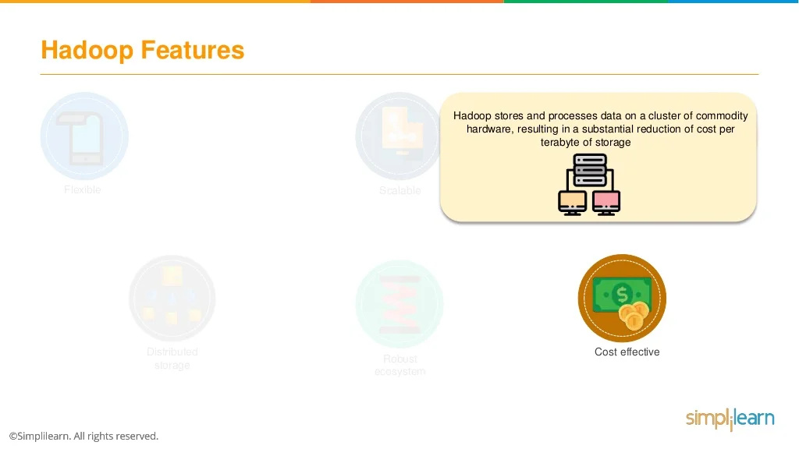

Slide 28
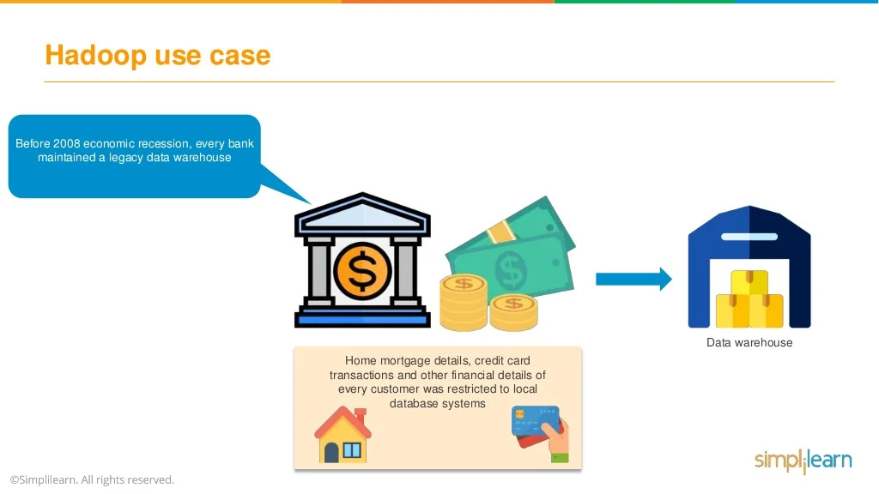

Slide 29
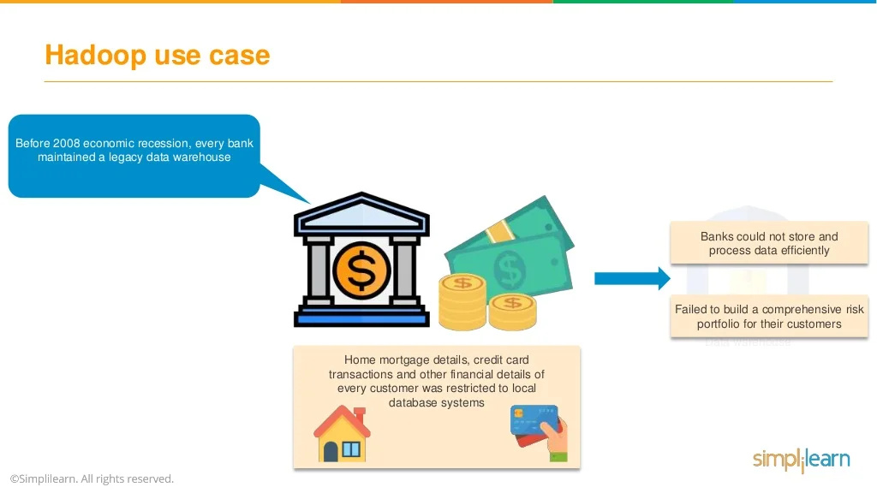

Slide 30
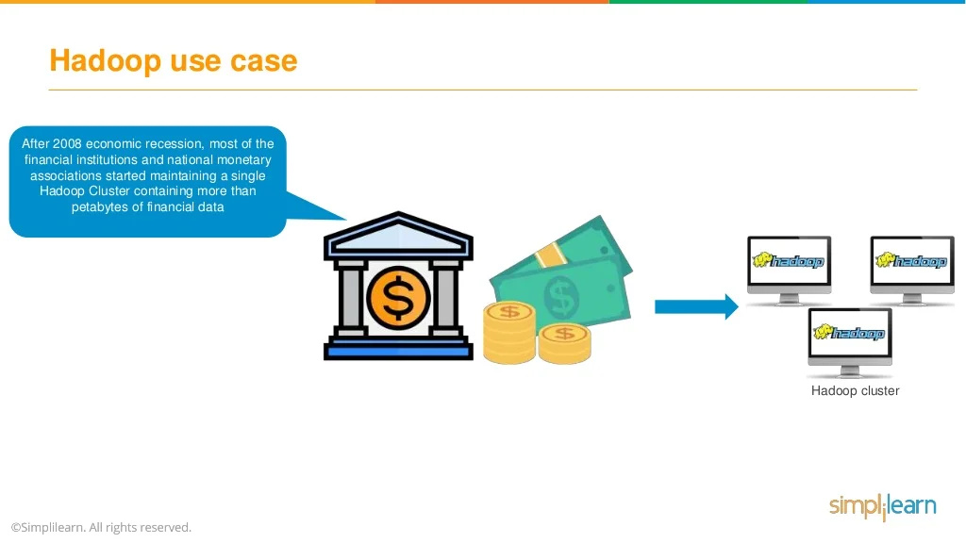

Slide 31
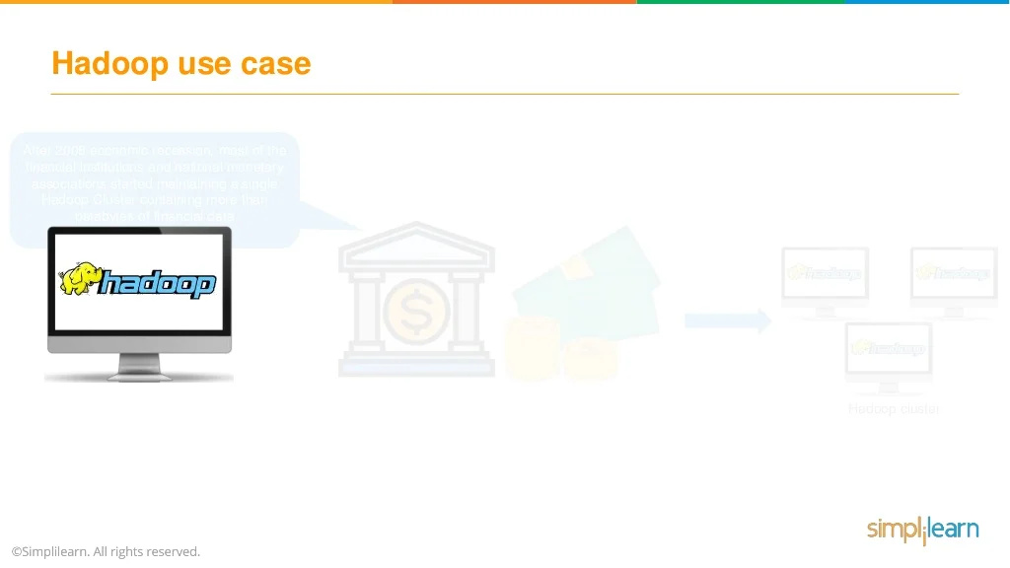

Slide 32
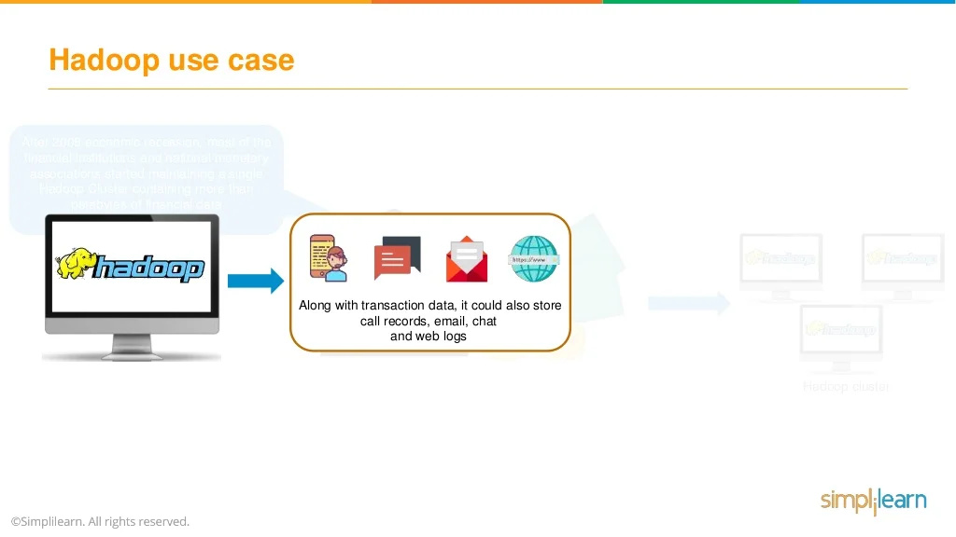

Slide 33
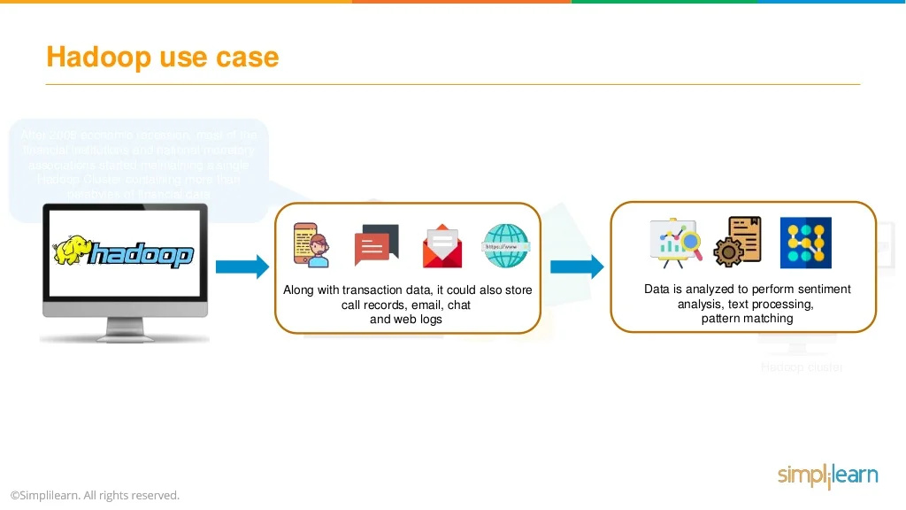

Slide 34
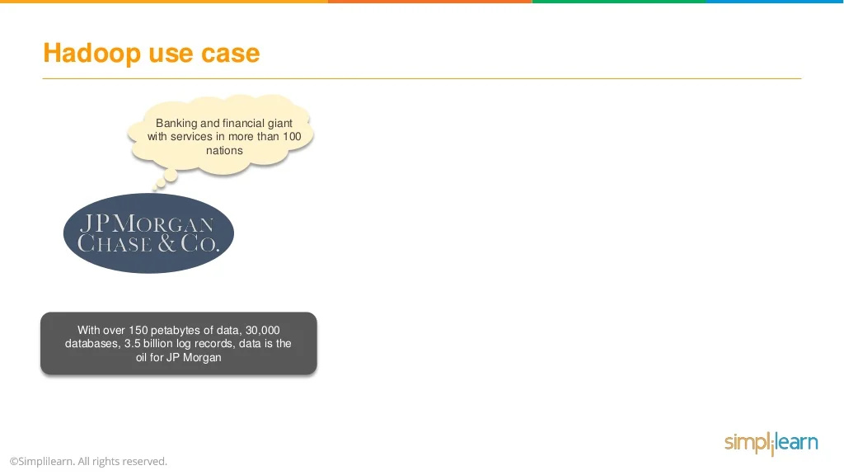

Slide 35
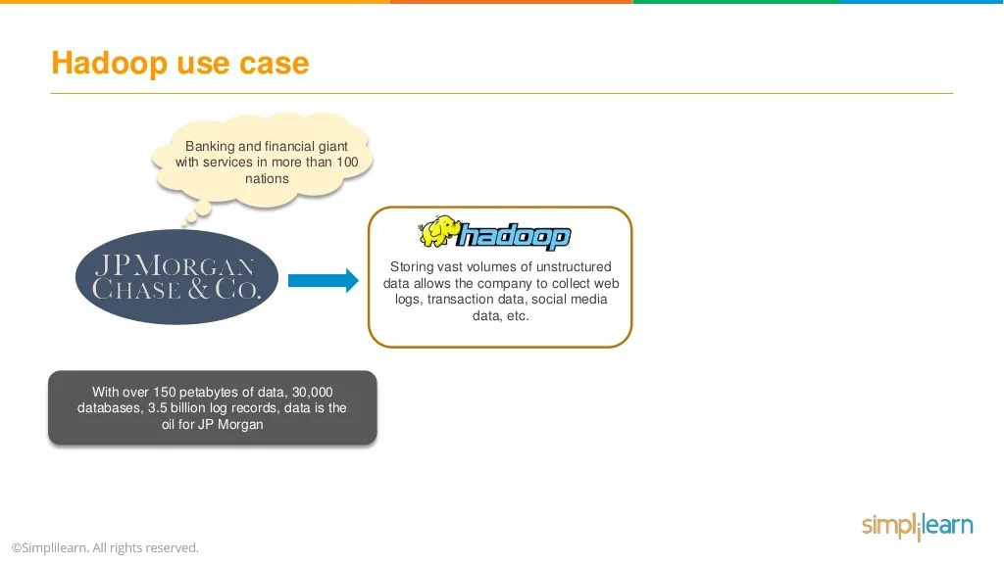

Slide 36
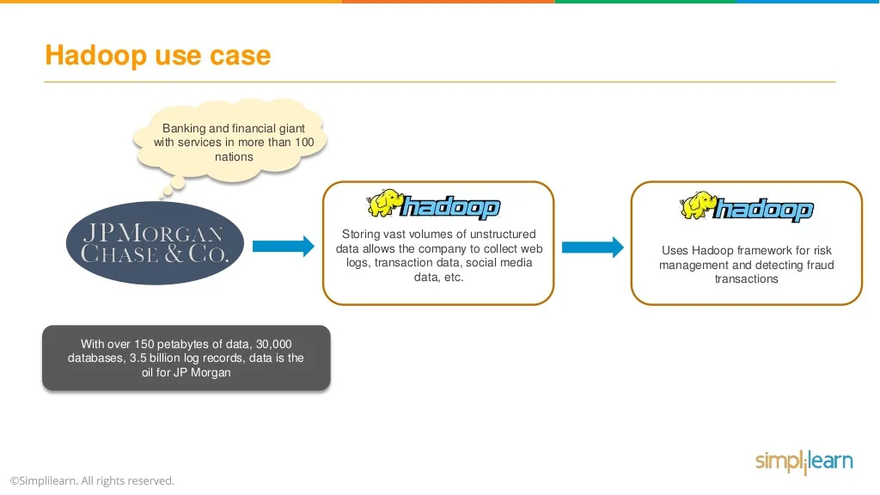

Slide 37
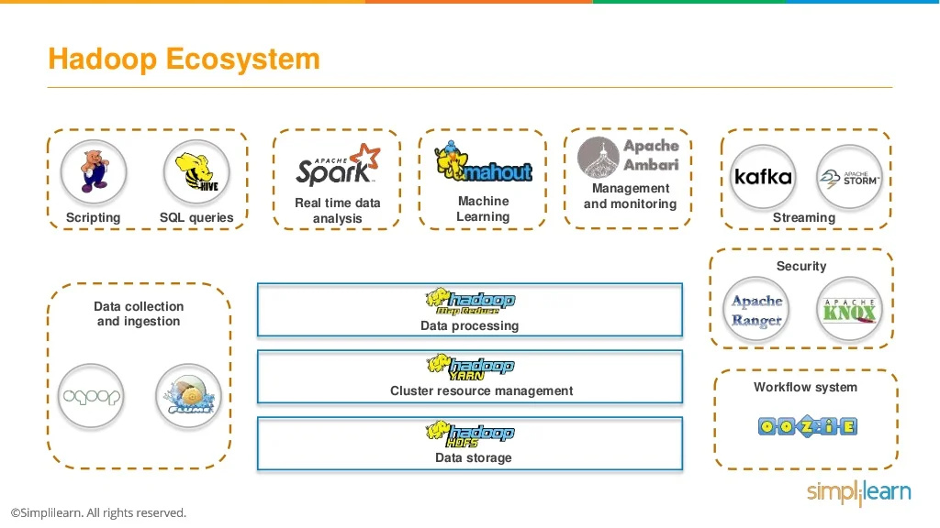

Slide 38
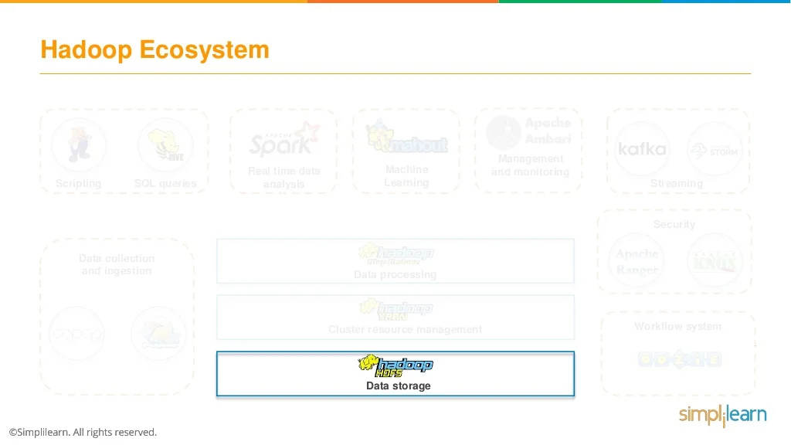

Slide 39
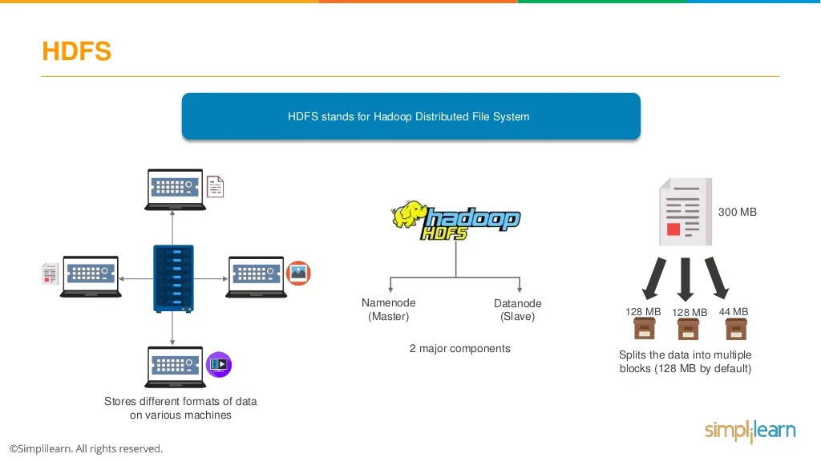

Slide 40
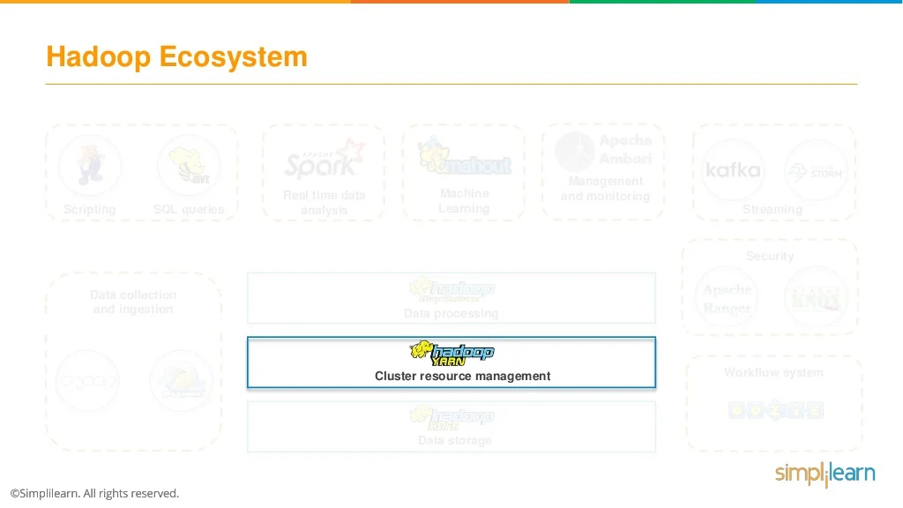

Slide 41
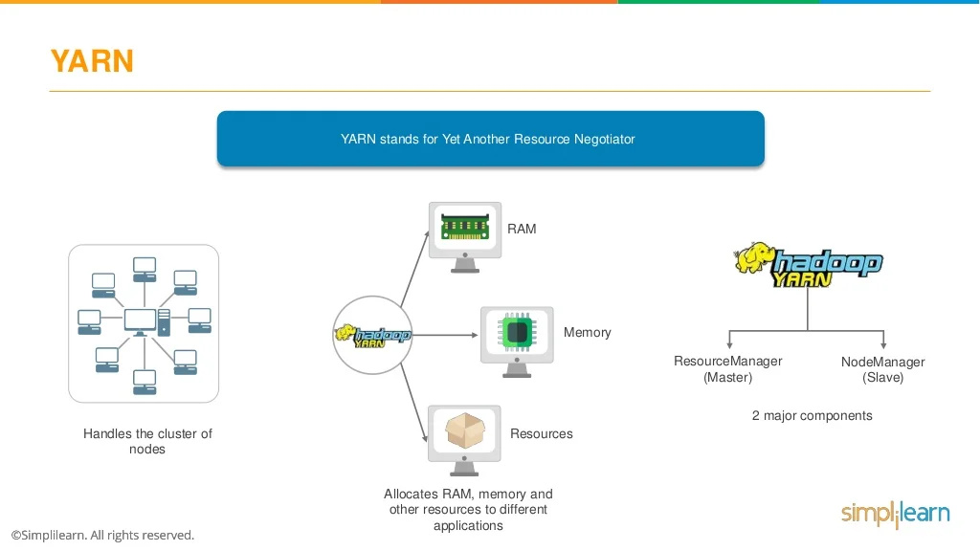

Slide 42
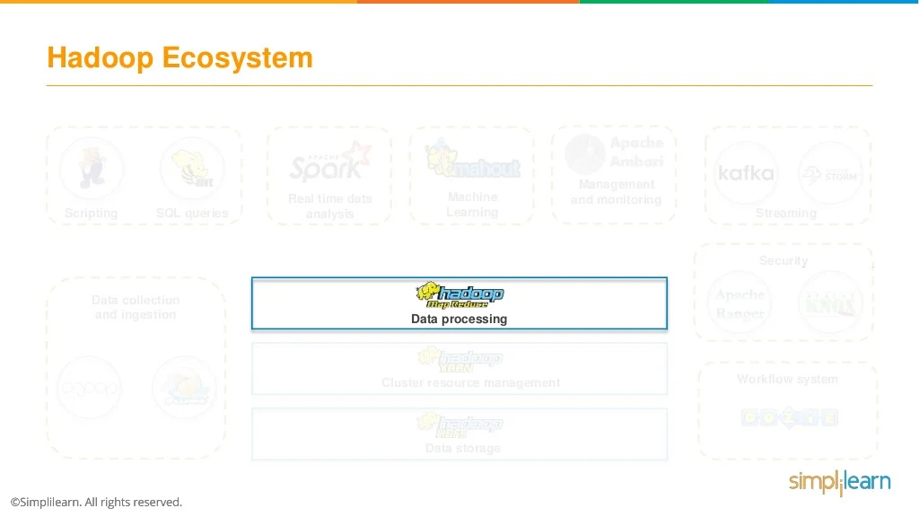

Slide 43
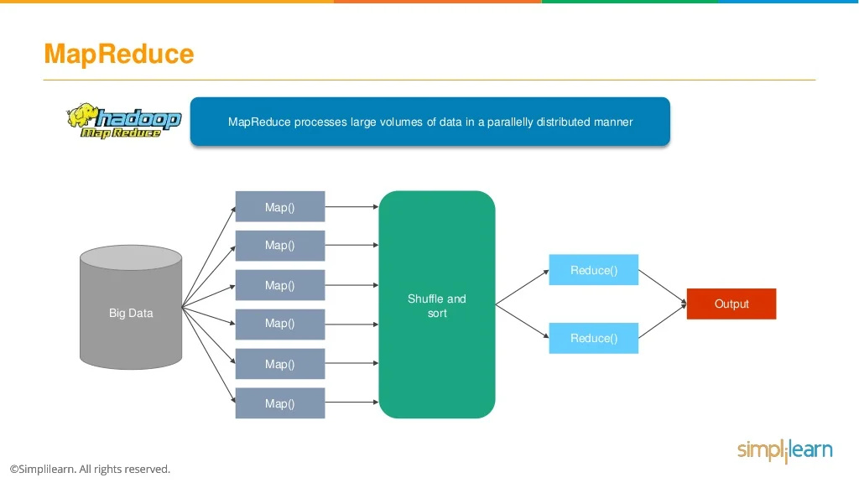

Slide 44
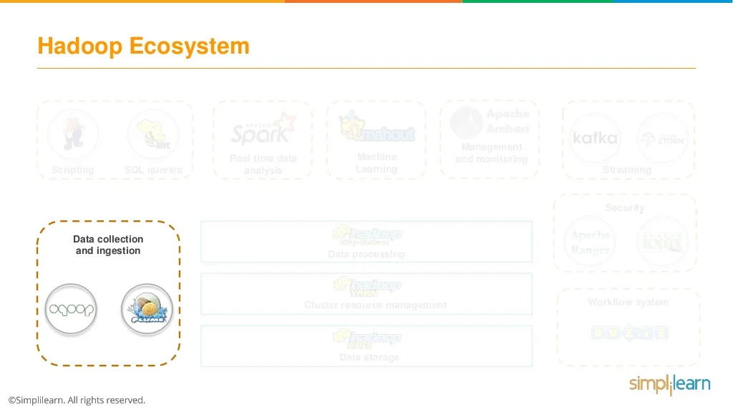

Slide 45
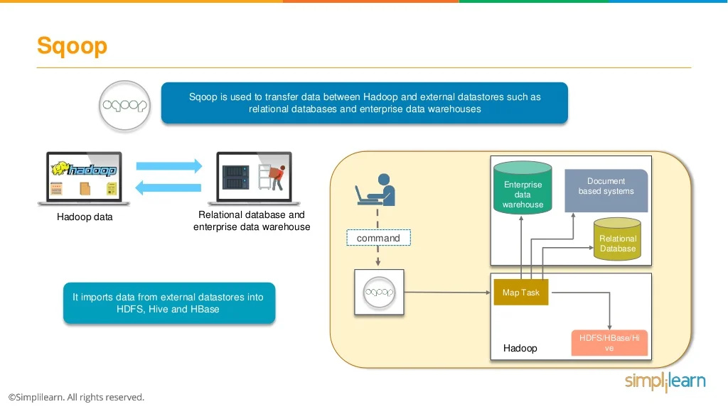

Slide 46
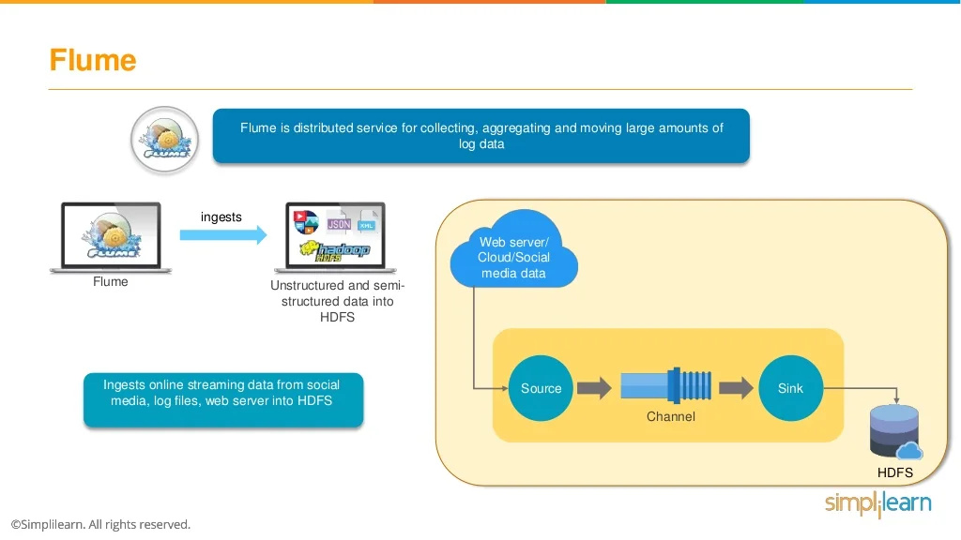

Slide 47
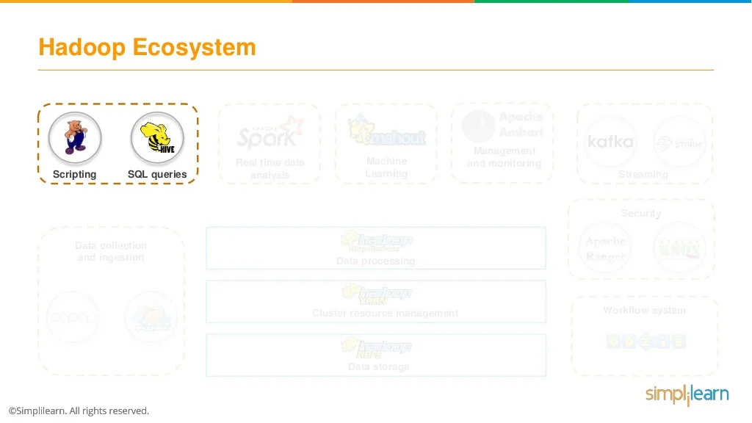

Slide 48
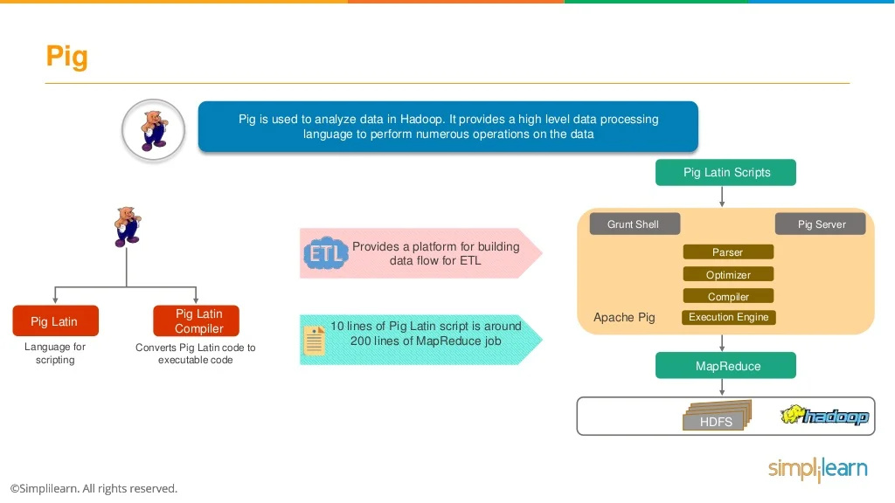

Slide 49
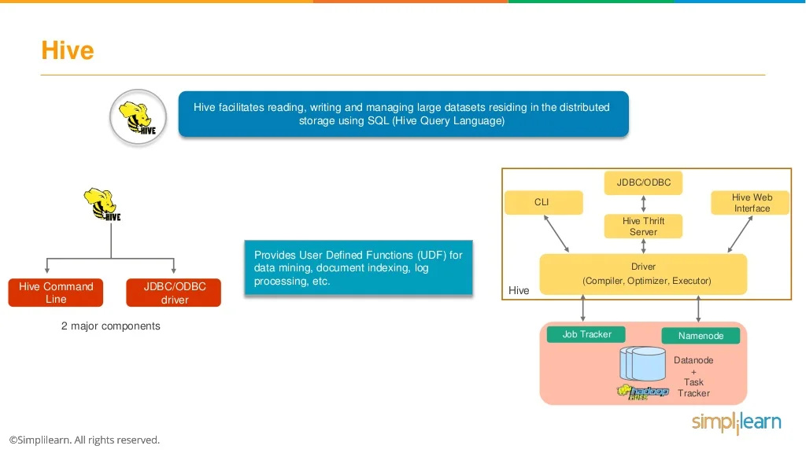

Slide 50
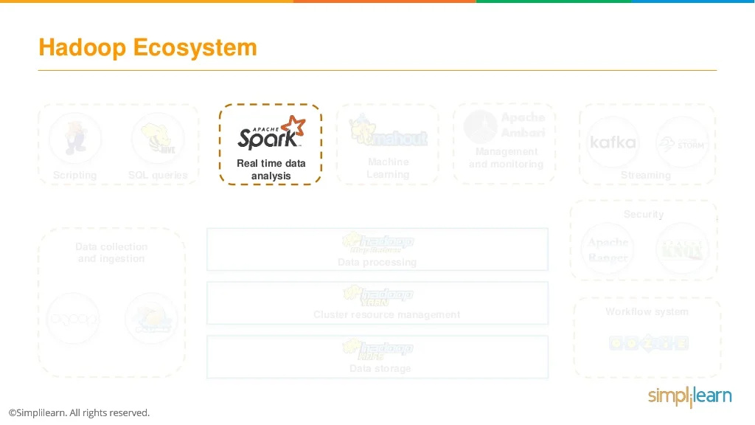

Slide 51
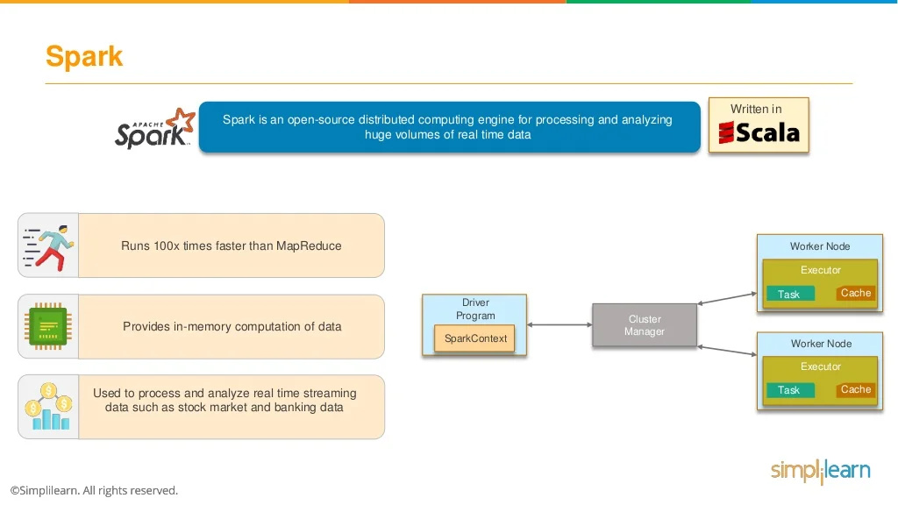

Slide 52
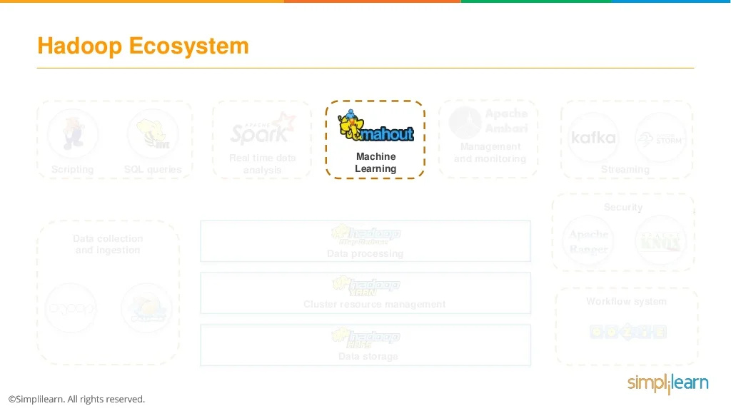

Slide 53
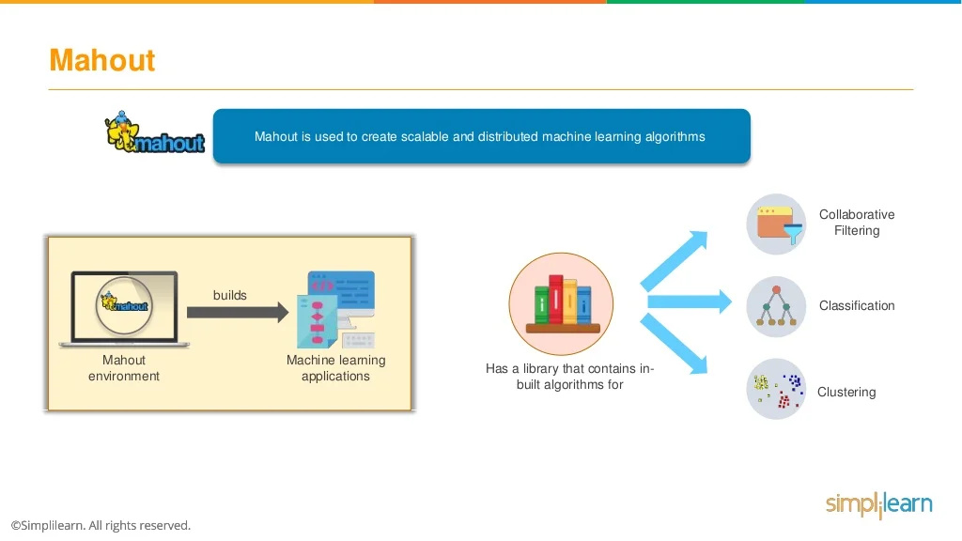

Slide 54
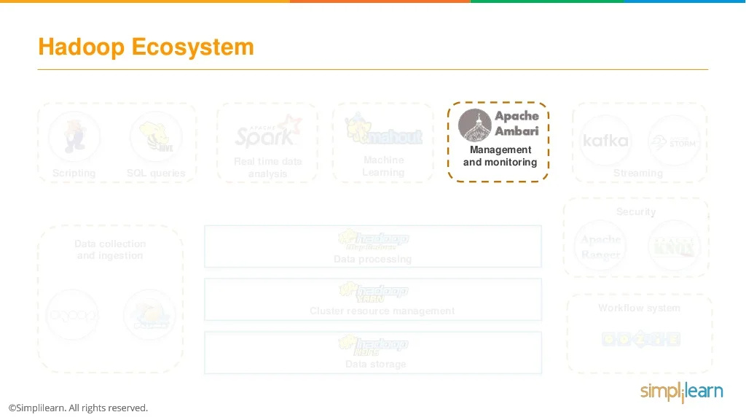

Slide 55
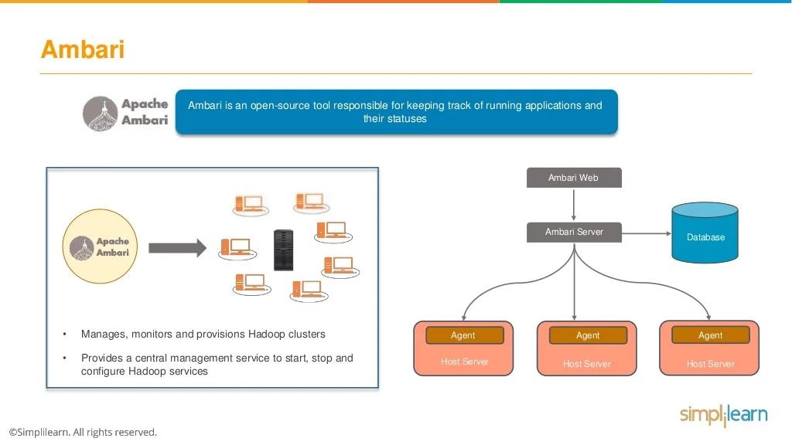

Slide 56
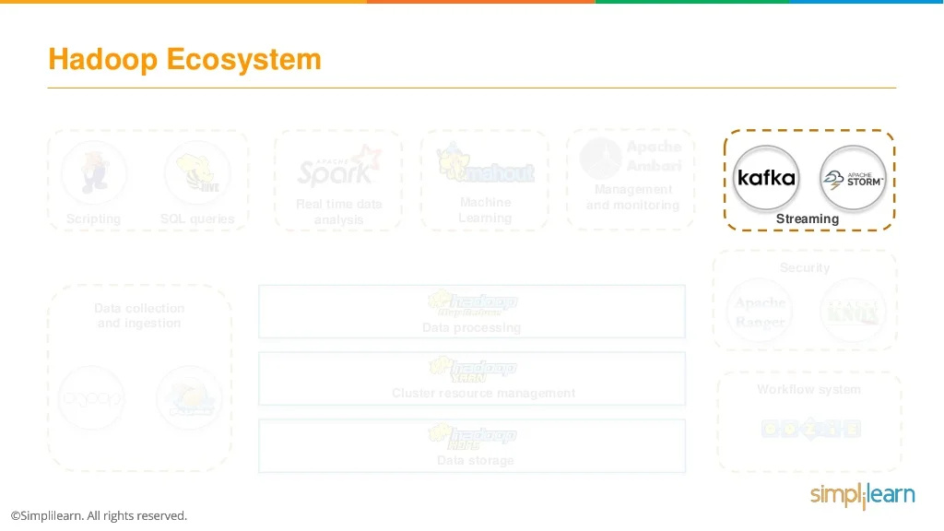

Slide 57


Slide 58


Slide 59


Slide 60


Slide 61


Slide 62


Slide 63


Slide 64


Slide 65


Slide 66


Slide 67


Slide 68


Slide 69


Slide 70


Slide 71


Slide 72


Slide 73


Slide 74


Slide 75


Slide 76
Name Node
Name Node is the master node in the Apache Hadoop HDFS Architecture that maintains and manages the blocks present on the Data Nodes (slave nodes).
Name Node is a highly available server that manages the File System Namespace and controls access to files by clients.

Slide 77
Functions of Name node
It is the master daemon that maintains and manages the DataNodes (slave nodes)
It records the metadata of all the files stored in the cluster
FsImage: It contains the complete state of the file system namespace since the start of the NameNode.
EditLogs: It contains all the recent modifications made to the file system concerning the most recent FsImage.

Slide 78
Functions of Name node
It records each change that takes place to the file system metadata.
It regularly receives a Heartbeat and a block report from all the data nodes in the cluster to ensure that the data nodes are live.
It records all the blocks in HDFS and which nodes these blocks are located.
The Name Node is also responsible for taking care of the replication factor of all the blocks which we will discuss in detail later in this HDFS tutorial blog.
In case of the Data Node failure, the Name Node chooses new Data Nodes for new replicas, balances disk usage, and manages the communication traffic to the Data Nodes.

Slide 79
Data Nodes
Data Nodes are the slave nodes in HDFS. Unlike Name Node, Data Node is commodity hardware, that is, a non-expensive system that is not of high quality or high availability.

Slide 80
Functions of Data Node
These are slave daemons or process which runs on each slave machine.
The actual data is stored on Data Nodes.
The Data Nodes perform the low-level read and write requests from the file system’s clients.
They send heartbeats to the Name Node periodically to report the overall health of HDFS; by default, this frequency is set to 3 seconds.

Slide 81

Secondary Name Node
Apart from these two daemons, there is a third daemon or a process called Secondary NameNode. The Secondary NameNode works concurrently with the primary NameNode as a helper daemon.

Slide 82
Functions of Secondary Name Node
The Secondary Name Node is one that constantly reads all the file systems and metadata from the RAM of the Name Node and writes it into the hard disk or the file system.
It is responsible for combining the EditLogs with FsImage from the Name Node.
It downloads the EditLogs from the Name Node at regular intervals and applies them to FsImage. The new FsImage is copied back to the Name Node, which is used whenever the Name Node is started the next time.

Slide 83

Replication Management
if you are storing a file of 128 MB in HDFS using the default configuration, you will end up occupying a space of 384 MB (3*128 MB) as the blocks will be replicated three times and each replica will be residing on a different DataNode.

Slide 84
Network Topology - Hadoop
What does it mean for two nodes in a local network to be “close” to each other?
Processes on the same node
Different nodes on the same rack
Nodes on different racks in the same data center
Nodes in different data centers

Slide 85


Slide 86
Network Topology - Hadoop
For example, imagine a node n1 on rack r1 in data center d1. This can be represented as /d1/r1/n1. Using this notation, here are the distances for the four scenarios:
distance(/d1/r1/n1, /d1/r1/n1)
= 0 (processes on the same node)
distance(/d1/r1/n1, /d1/r1/n2)
= 2 (different nodes on the same rack)
distance(/d1/r1/n1, /d1/r2/n3)
= 4 (nodes on different racks in the same data center)
distance(/d1/r1/n1, /d2/r3/n4)
= 6 (nodes in different data centers)

Slide 87
Summary Design Criteria of HDFS
Very large files
Lots of small files
Petabyte-scale data
Growing of filesystem metadata
Streaming data access
Random data access
Write-once, read-many-times
High throughput
Multiple writers, arbitrary file update
Low latency
Commodity hardware
Node failure handling

Slide 88
RDBMS vs. Hadoop
RDBMS | Hadoop
Traditional row-column based DB, used for data storage, manipulation and retrieval. | An open-source software used for storing data and running applications or processes concurrently.
Structured data is mostly processed. | Both structured and unstructured data is processed.
Best suited for OLTP environment. | Best suited for BIG data.
Less scalable than Hadoop. | Highly scalable.
Data normalization is required. | Data normalization is not required.
Stores transformed and aggregated data. | Stores huge volume of data.
No latency in response. | Some latency in response.
Data schema of RDBMS is static. | Data schema of Hadoop is dynamic.
High data integrity available. | Low data integrity available than RDBMS.
Cost is applicable for licensed software. | Free of cost, as it is an open source software.

Slide 89
Configuration XML files in Hadoop
hadoop-env.sh
This file specifies environment variables that affect the JDK used by Hadoop Daemon (bin/Hadoop). (JAVA_HOME)
It informs the Hadoop daemon where Name Node runs in the cluster. It contains the configuration settings for Hadoop Core such as I/O settings that are common to HDFS and MapReduce.

Slide 90
Configuration XML files in Hadoop
hdfs-site.xml
This is the main configuration file for HDFS. It defines the name node and data node paths as well as the replication factor.
Replication factor is specified by dfs.replication property; as it is a single node cluster hence we will set replication to 1.
The default heartbeat interval is 3 seconds. One can change it by using dfs.heartbeat.interval in hdfs-site.xml.
mapred-site.xml
In order to specify which framework should be used for MapReduce, we use mapreduce.framework.name property, yarn is used here.

Slide 91
Configuration XML files in Hadoop
yarn-site.xml
In order to specify auxiliary service need to run with nodemanager “yarn.nodemanager.aux-services” property is used.
Here Shuffling is used as auxiliary service. And in order to know the class that should be used for shuffling we user “yarn.nodemanager.aux-services.mapreduce.shuffle.class”
core-site.xml
This file defines port number, memory, memory limits, size of read/write buffers used by Hadoop. Find this file in the etc/hadoop directory
Location of namenode is specified by fs.defaultFS property namenode running at 9000 port on localhost.
hadoop.tmp.dir property to specify the location where temporary as well as permanent data of Hadoop will be stored.

Slide 92


Slide 93


Slide 94


Slide 95


Slide 96

Anatomy of a File Write
(file exist & permission check)
enqueue packet
to data queue
dequeue the packet
from ack queue
chose by replica placement strategy
move the packet
to ack queue
https://d2h0cx97tjks2p.cloudfront.net/blogs/wp-content/uploads/sites/2/2016/05/Data-Write-Mechanism-in-HDFS.gif

Slide 97

Anatomy of a File Write

Slide 98
Anatomy of a File Write (cont’d)
Error handling
Datanode error while data is being written
Client
Adds any packets in the ack queue to data queue
Removes the failed datanode from the pipeline
Writes the remainder of the data
Namenode
Arranges under-replicated blocks for further replicas
Failed datanode
Deletes the partial block when the node recovers later on

Slide 99


Slide 100


Slide 101


Slide 102

Anatomy of a File Read
(according to network topology)
(first block)
(next block)

Slide 103

Anatomy of a File Read

Slide 104
Anatomy of a File Read (cont’d)
Error handling
Error in client-datanode communication
Try next closest datanode for the block
Remember failed datanode for later blocks
Block checksum error
Report to the namenode
Key point
Client contacts datanodes directly to retrieve data

Slide 105


Slide 106


Slide 107

Basic Filesystem Operations

Slide 108
Basic Filesystem Operations
Copying a file from the local filesystem to HDFS
Copying the file back to the local filesystem
Creating a directory
% hdfs dfs –copyFromLocal input/docs/quangle.txt hdfs://localhost/user/tom/quangle.txt
% hdfs dfs –copyToLocal hdfs://localhost/user/tom/quangle.txt
quangle.copy.txt
% hdfs dfs –mkdir books
% hdfs fs -ls .
Found 2 items
drwxr-xr-x - tom supergroup 0 2009-04-02 22:41 /user/tom/books
-rw-r--r-- 1 tom supergroup 118 2009-04-02 22:29 /user/tom/quangle.txt

Slide 109


Slide 110


Slide 111


Slide 112


Slide 113


Slide 114


Slide 115


Slide 116


Slide 117


Slide 118


Slide 119


Slide 120


Slide 121
RDBMS vs. MapReduce
 | Traditional RDBMS | MapReduce
Data size | Gigabytes | Petabytes
Access | Interactive and batch | Batch
Updates | Read and write many times | Write once, read many times
Transactions | ACID | None
Structure | Schema-on-write | Schema-on-read
Integrity | High | Low
Scaling | Nonlinear | Linear

Slide 122


